Slide 1
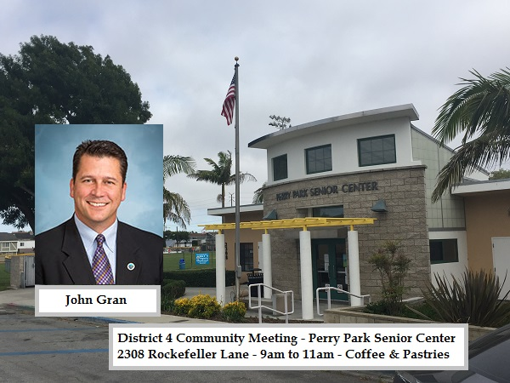
Virtual Community Meeting
Sorry, You are on Your Own Today!

Slide 2
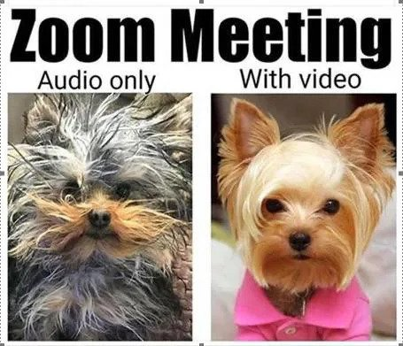
For Today’s Meeting, here’s how you can ask questions:
VIA COMPUTER: To participate: Click on “Raise Hand” button to request to speak on any given agenda item and begin speaking when prompted
Also, if you don’t want speak you can send me your question via the “Chat” function within Zoom. send me your question and I’ll read and answer if for you.
VIA PHONE: To participate: Press *9 at the time your requested agenda item is called and begin speaking when prompted
Sorry, no chat available for “Phone Only” folks.

Slide 3
Today’s Agenda:
About 10 Minutes
Testing the Info.
About 45 Minutes
About 25 Minutes

Slide 4
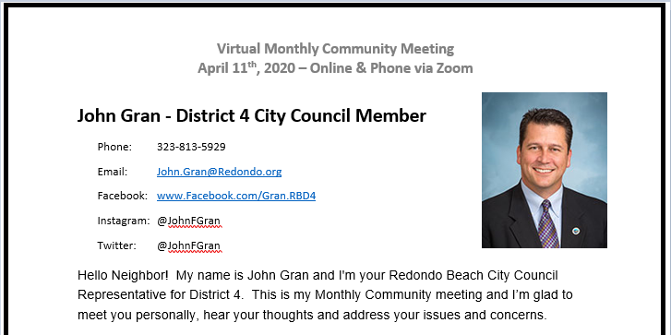
Introducing: Redondo Beach City Councilman – John Gran
You Spoke, and I’m Listening:
“It’s time the City pays Full Attention to North Redondo Beach!”
“That’s great, but how are you going to pay for that?”

Slide 5
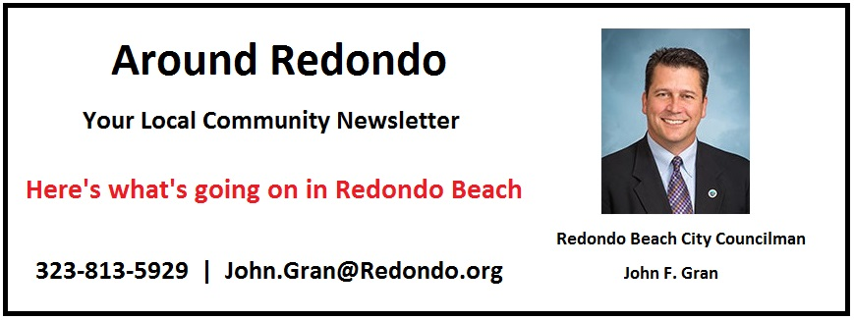
Introducing: Redondo Beach City Councilman – John Gran
Multiple Online Comments: “What is going on with Redondo Beach?”
You Spoke, and I’m Listening:
I’ve created this newsletter to share Local Information:
To Sign Up, visit www.JohnGran.com or send me an email.

Slide 6
OK, Time for Our First Online Poll:
Before Today - How many community meetings w/ Councilman John Gran have you attended? ( Single Choice)
Answer 1: This is my First Meeting - It's Virtual, and I'm Stuck at Home Anyway.
Answer 2: One Meeting - I Checked It Out Once and Virtual May be Way Better - We'll See...
Answer 3: Two Meetings - I was Curious To See If John just say's the same thing each time.
Answer 4: Three Or More - I Can't Get Enough of John's Wisdom, Wit and Good Sense of Humor!
Answer 5: What? Who's John? Sorry, I'm on the Wrong ZOOM...My Bad - Bye!

Slide 7
OK, Let’s Get Started:
Introducing Special Guest: Jacqueline Sun w/ Beach Cities Health District
What Actions has the City taken?
How are the Fire Department and Police Department handling issues?
What is going on with the testing at the Galleria?
Where can I get additional local COVID-19 information?
5. Question Time: Please “Raise Your Hand” or send me your question via “Chat”
Closing Remarks

Slide 8
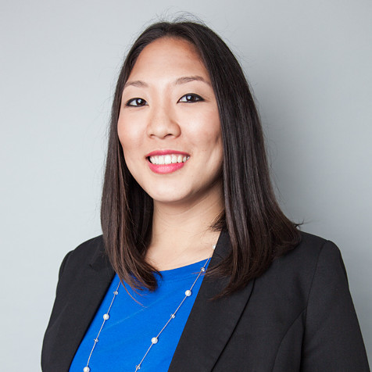
Introducing:
Jacqueline Sun Senior Policy Analyst at Beach Cities Health District

Slide 9
COVID-19 Updates:
What Actions has the City taken?
March 12th: Proclamation of Local Emergency
March 16th: Closed City Facilities, Cancelled Commission Meetings
March 17th: Issued Local “Safer At Home” Order, Closed non-essential businesses
March 19th: Closed Playground Equipment, Closed Wilderness Park
March 21st: Reconciled Local Orders with LA County’s “Safer At Home” Order
March 26th: Closed Esplanade, Beach Accesses and Public Walkways
April 9th: Local “Masks Required” Order (LA County issued on 4/10/2020)
https://www.redondo.org/depts/city_manager/coronavirus_update.asp

Slide 10
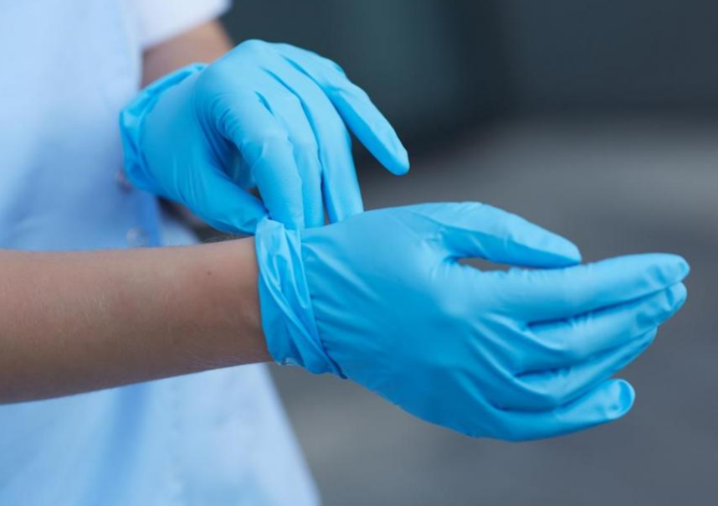
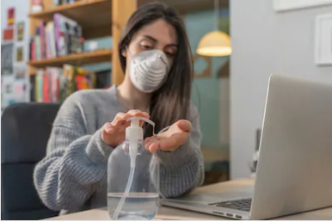
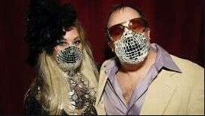
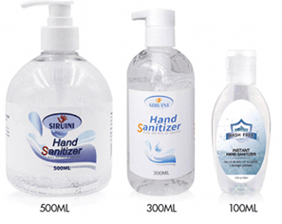
For ALL of our safety, please Do Your Best to Comply with the Local, County and State Orders – We are all in this together.

Slide 11
Second Poll – Social Distancing Issue: What Should You Do?
A group of neighbors are not “Socially Distancing” while also letting their kids run around. What do you do?
Answer 1: Yell out of the window, “What the Heck are you Doing? Get Away From Each Other!”
Answer 2: Write a searing post on Nextdoor.com with Pictures – get lots of comments.
Answer 3: Text Councilman John Gran and tell him to break that group up immediately!
Answer 4: Do Nothing – Host a Zoom Virtual Happy Hour and share the details with friends.
Answer 5: Call the Police Administration Line 310-379-5411 and provide the details

Slide 12
Important:
If you do have an emergency
always Call 911!
Correct Answer:
Call the Police Non-Emergency Number and let them know all the details.
The Police have personnel that will check this type of activity out, without pulling resources away from “regular” police work.
Tip: You Should Put this Number in your Phone’s Contacts
Special thanks to Councilwoman Laura Emdee for the picture / graphics!

Slide 13
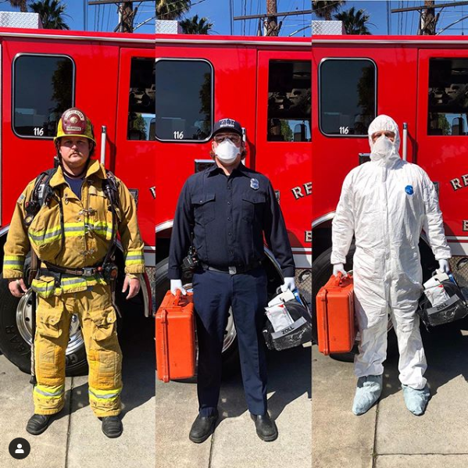
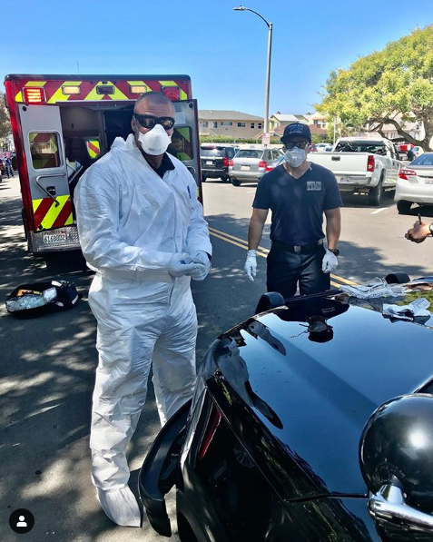
How are our First Responders Doing?

Slide 14
How are our First Responders Doing?
How are the Fire Department and Police Department handling issues?
Special shifts, engagement processes
All Sworn officers are wearing the blue uniforms
Fire Department monitors temperatures every 12 hours
Police crews do not interact during shift changes
Special testing and accommodations – before, during and after shifts
Contingency plans in place should significant members become COVID-19 Positive

Slide 15
COVID-19 Testing: What Do I Need to Know?
If you are experiencing acute symptoms such as severe shortness of breath or are in distress related to COVID-19 symptoms, contact your physician.
If it is an emergency, dial 911. For more questions about testing, please visit the City of Los Angeles' FAQ for answers to frequently asked questions.
If you or someone you know in the Beach Cities needs assistance with errands, health-related information or referral, please call our Assistance, Information & Referral line at 310-374-3426, ext. 256, seven days a week, 8:30 a.m. – 5 p.m. You can also visit us online at bchd.org/resources.

Slide 16
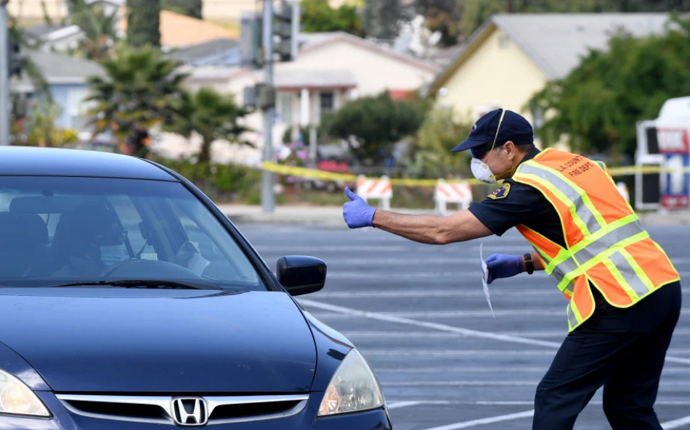
COVID-19 Testing: What Do I Need to Know?
LACDPH COVID-19 Testing at the South Bay Galleria
Testing will be for people over 65 who have symptoms.
Testing is "by appointment" - No walk-ups will be taken
You must schedule an appointment
Completely Safe, You stay in your car, results within 48 hours.
Testing began last Saturday (04/04/2020).
As mentioned previously, If you are feeling ill, call your doctor. If you are having an emergency, Call 911
If you have questions, call The BCHD Hotline 310-374-3426, ext. 256

Slide 17
Third Poll – Where do you currently get your Local Information?
For Local COVID-19 information I go to the following places:
Answer 1: Facebook, Instagram, Nextdoor – Online Social Media Sites
Answer 2: Beach Reporter and Easy Reader – Online and Print News
Answer 3: Redondo Beach’s Official Website – City’s Communication Platforms
Answer 4: Beach Cities Health District – Newsletters and Website
Answer 5: Online news sources – Dailybreeze.com, LATimes.com, etc.

Slide 18
Where Can I Get Local Information?
And Other Social Media Sites
Good: For Connecting with Neighbors and Friends – Sharing your experiences
Bad: Lots of Opinions, Complaints, Rumors and Potential Mis-Information

Slide 19
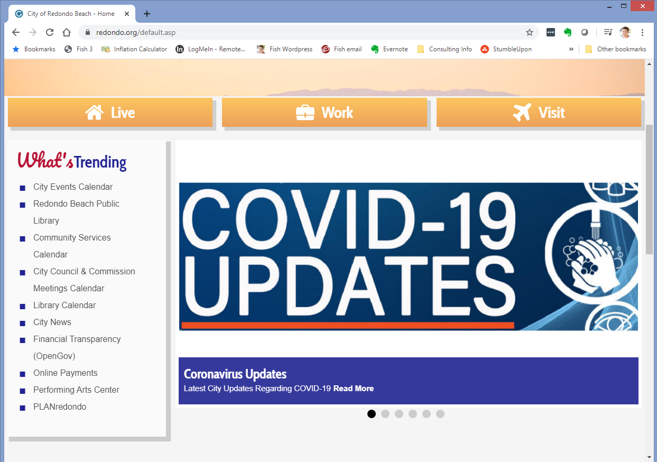
Where Can I Get Local Information?
Source #1: www.Redondo.org – Our City’s Official Website

Slide 20
Where Can I Get Local Information?
Source #2: Beach Cities Health District – Newsletters and Website
If you have questions, call The BCHD Hotline 310-374-3426, ext. 256
To Sign Up for their Weekly Newsletter: visit www.BCHD.com
https://www.bchd.org/newsletter-sign

Slide 21
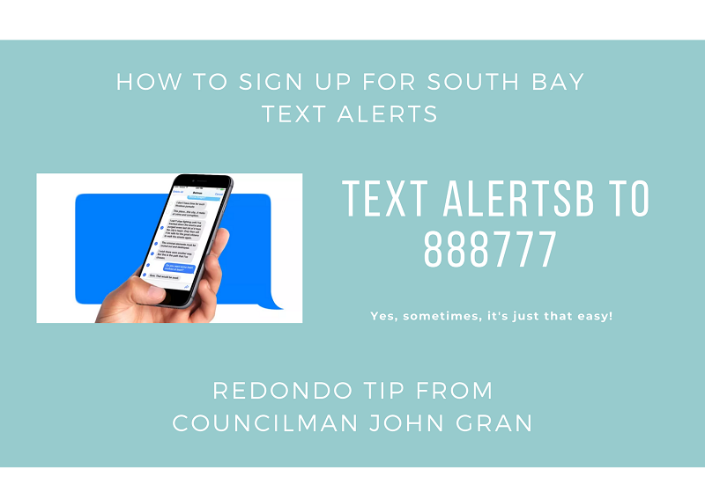
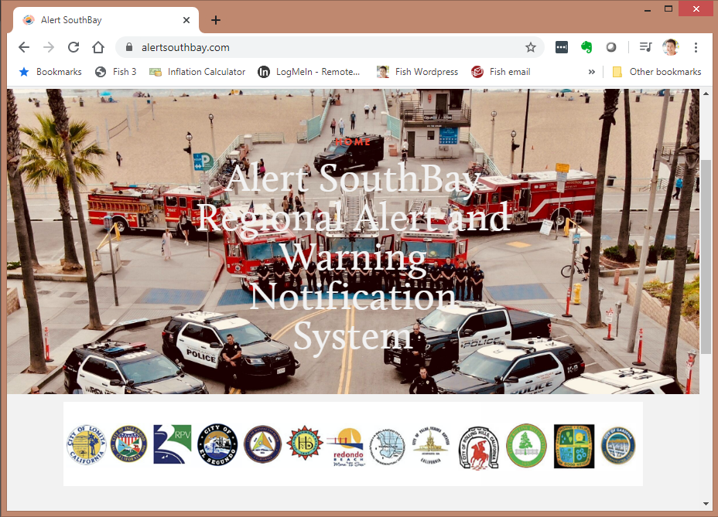
Where Can I Get Local Information?
Source #3: South Bay Alerts – Text and Email Alerts
www.AlertSouthBay.com
Sign Up via Text – ALERTSB to 888777

Slide 22
Where Can I Get Local Information?
Source #4: Email, Text and Call Councilman John Gran
Also, visit www.JohnGran.com – I’m happy to help!

Slide 23
Where Can I Get Local Information?
Source #5: Attend a Community Meeting and Ask Questions!

Slide 24
Finally, How’s Redondo Beach Doing? Any Updates?
There’s Still A Lot Going On in Redondo Beach!
$900mm Galleria Plans – Estimated 10 Months
SCE Greenbelt / Right of Way – Almost Done!
AES Power Plant – Sale has Closed!
Budget Season – May 16th is when the 20/21 budget arrives
Any Other Topics you’d like to Discuss!

Slide 25
Wrapping Up – Any Final Questions?
Please “Raise Your Hand” or send your question via “Chat”

Slide 26
Virtual Community Meeting
Sorry, You are on Your Own Today!

